Slide 1

Intelligence system and robotics
Individual presentation
DHANESH RAJU 2311363

Slide 2


Agenda:
PID CONTROLLER
FUZZY LOGIC RIGHT EDGE
OBSTACLE AVOIDANCE
CONTROL ARCHITECTURE

Slide 3
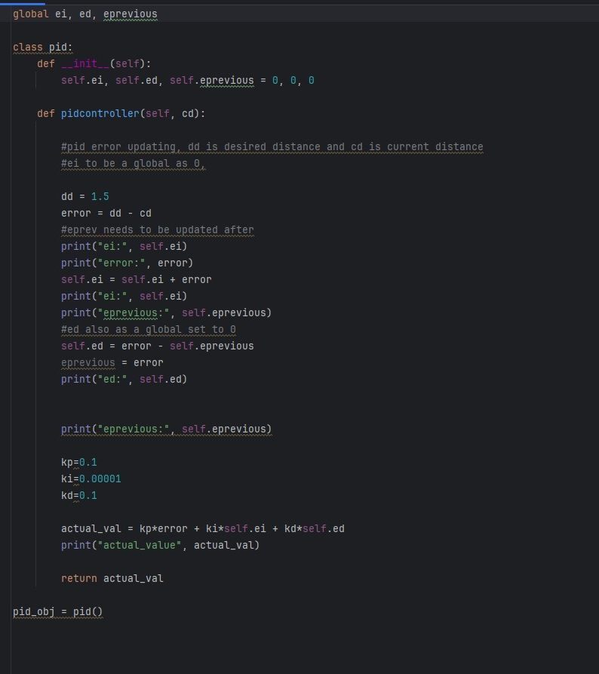
PID controller
Here in PID Controller, I’ve
Used desire distance as 1.5, KP as 0.1, KI as 0.00001, KD as 0.1.
I considered the fright parameters from LIDAR sensor for the calculation to work with PID, I’ve used multi combinations for the KP, KI, KD but when compared to other parameters the current parameters gives the better output and performance.

Slide 4
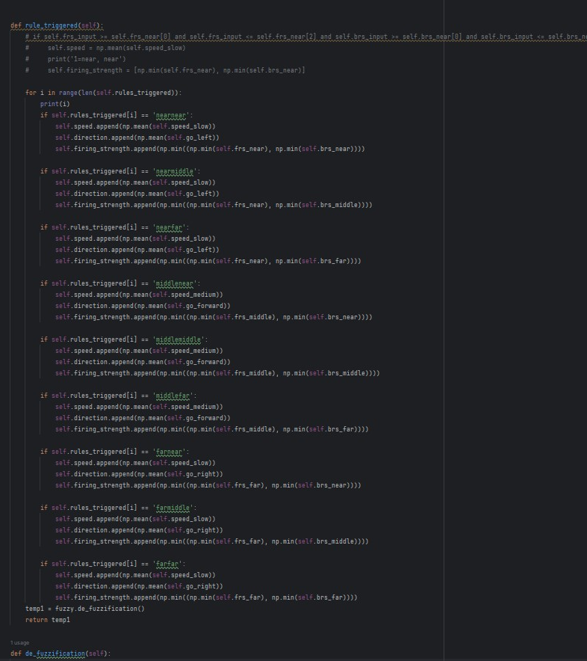
Fuzzy logic Right edge:
Here in Fuzzy Logic, Using 9 rule base to triggered the right rules to follow the right edge following. I’ve used LIDAR Sensor and passing parameter as fright and fback
In Fuzzy Logic we have 2 inputs and 2 outputs and for each input and output we have membership values, by using membership values we will find it falls in rising edge or falling edge this process is part of defuzzification.

Slide 5
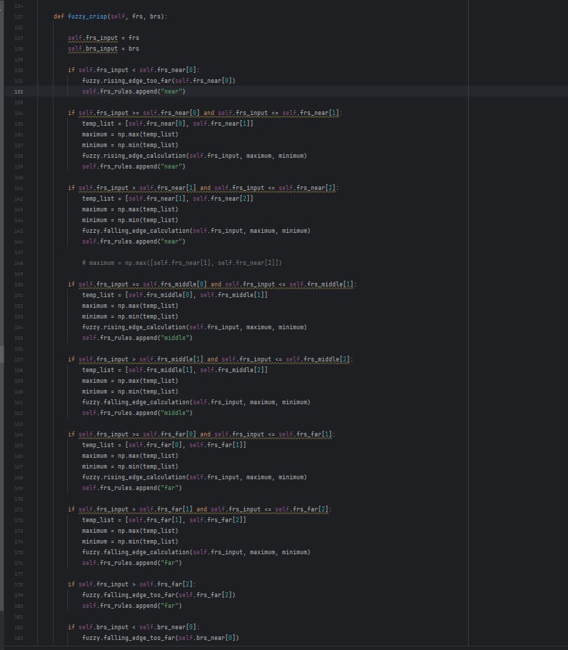
Fuzzy logic right edge:
I’ve used 16 conditions to find its raising edge or falling edge. Here each condition performs certain task.
After finding the fuzzy crisp parameters we will find which rule is triggered, by using those firing rules we find the certain outputs like speed and directions. And we performed fuzzification to find the minimum of those outputs and passed to robot. So, by using those parameters robot will follow RIGHT Edge Following.

Slide 6
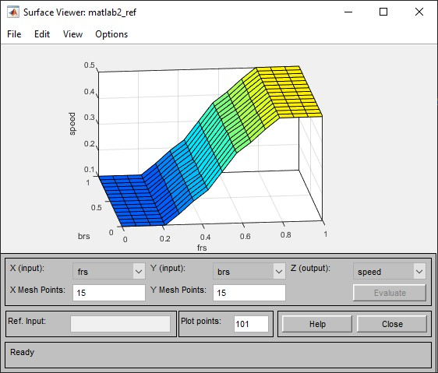

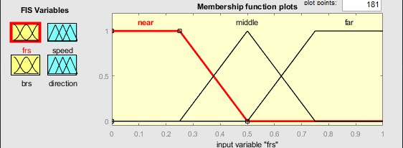
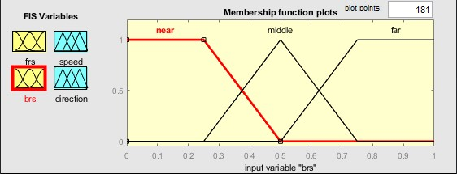
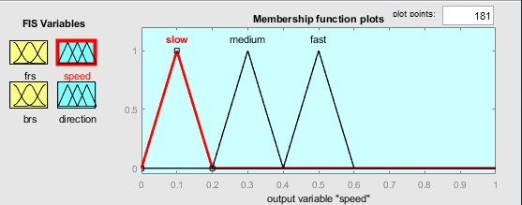
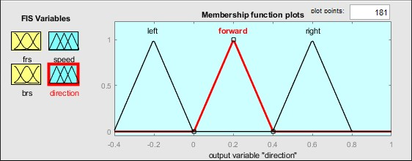
Fuzzy logic right edge:
By using MATLAB, we will get tuned membership values with perfect slop of surface, if the surface is without any zigzag or cross line in surface by this, robot will move without any collusion and follow right edge.
The below 4 graphs shows, graph for 2 input and 2 output parameters after getting the tuned values

Slide 7
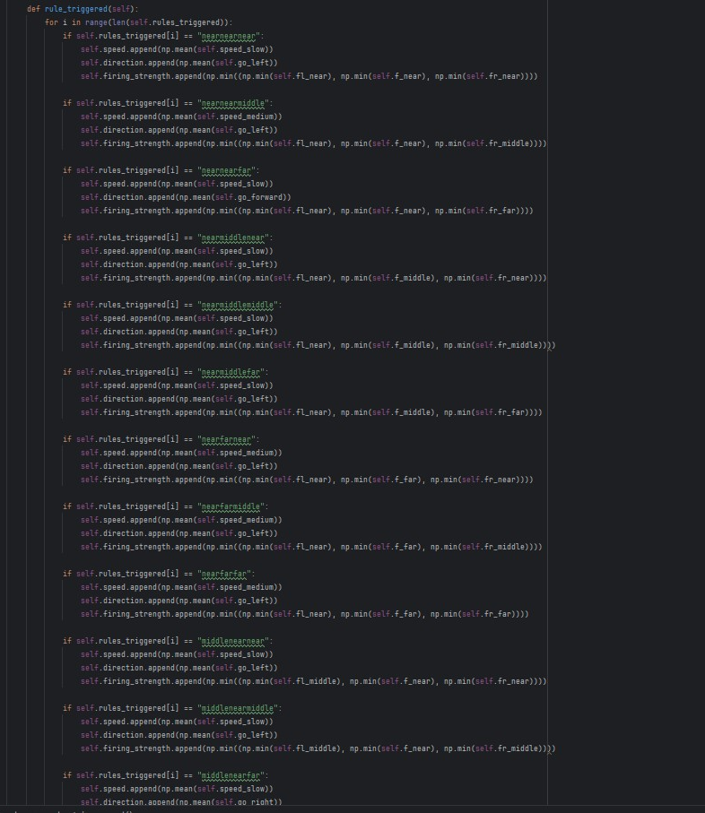
Obstacle avoidance:
Here in Obstacle Avoidance, Using 27 rule base to triggered the right rules to move without hitting obstacle. I’ve used LIDAR Sensor and passing parameter as front1, front2, right and left
In Obstacle Avoidance we have 3 inputs and 2 outputs and for each input and output we have membership values of length of 3, by using membership values we will find it falls in rising edge or falling edge this process is part of defuzzification.

Slide 8
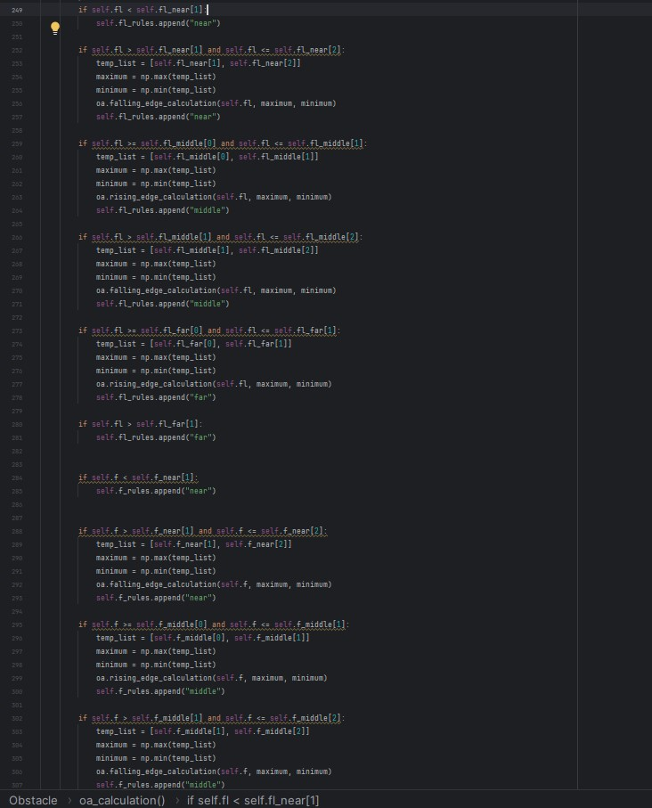
Obstacle avoidance:
I’ve used 18 conditions to find its raising edge or falling edge. Here each condition performs certain task.
After finding the fuzzy crisp parameters we will find which rule is triggered, by using those firing rules we find the certain outputs like speed and directions. And we performed fuzzification to find the minimum of those outputs and passed to robot. So, by using those parameters robot will move without hitting objects.

Slide 9
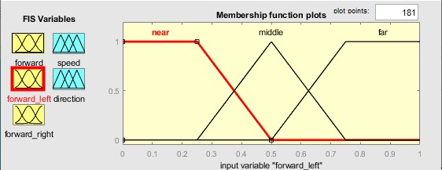
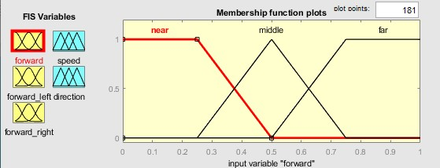
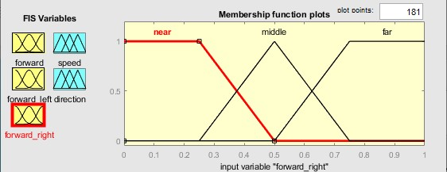
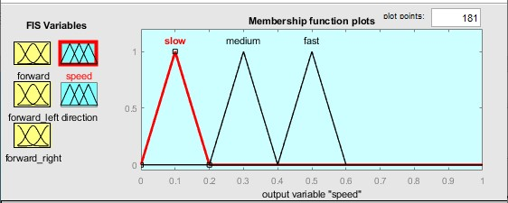
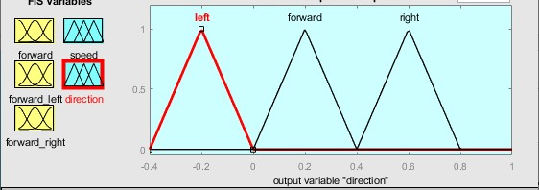
Obstacle avoidance:
By using MATLAB, we will get tuned membership values with perfect slop of surface, if the surface is without any zigzag or cross line in surface by this, robot will move without any collusion to the respective object.
The below 5 graphs shows, graph for 3 input and 2 output parameters after getting the tuned values.

Slide 10
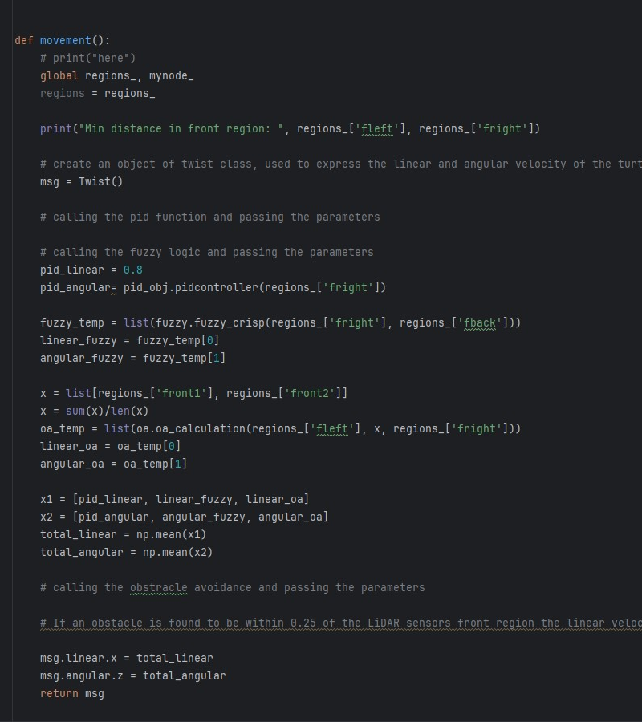
Control Architecture:
In combination of Fuzzy logic, I’ve made all the file as static for all PID, Fuzzy Logic and Obstacle Avoidance. Here in this file importing all the files and by using the function call we can access the all parameters and outputs
After performing all task, we get 3 outputs for the linear and 3 outputs for angular in both we are taking the mean and passing to the bot, According to this parameters robot will move.

Slide 11

THANK YOU
Dhanesh Raju
https://dhaneshraju.github.io/

